Slide 1

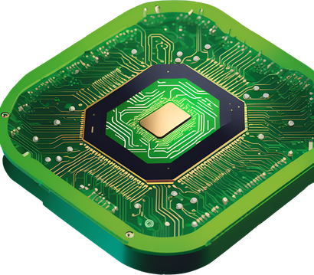
CUDA
CUDA programming

Slide 2
CUDA
Host (CPU)
Programming Model
Manages execution flow, memory allocation, kernel launches
Device (GPU)
Executes kernels in parallel
Must allocate/copy memory from host

Slide 3
CUDA
CUDA Function Qualifiers
__global__:A kernel function called from host, runs on device.
__device__:A device-only function. Can be called by kernels or other device functions.
__host__:A regular CPU function (default if you omit qualifiers).

Slide 4
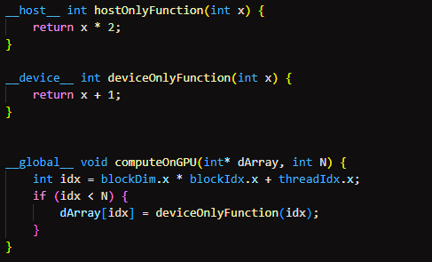
CUDA

Slide 5
CUDA
Thread Hierarchy
Grid: Contains multiple blocks
Block: Contains multiple thread
Thread: The smallest execution unit

Slide 6
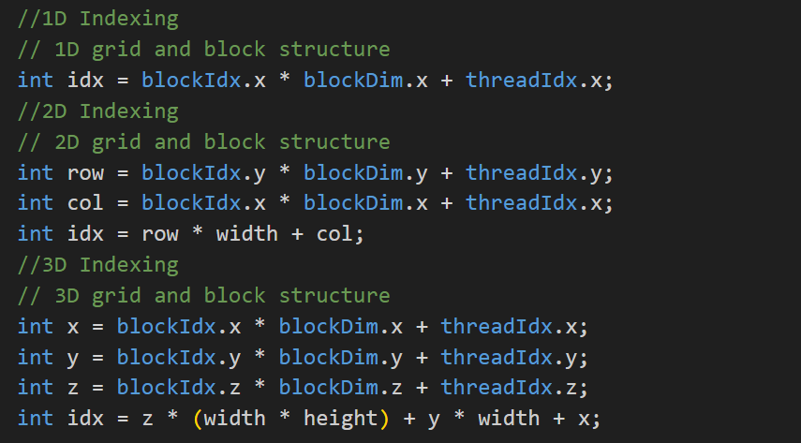
CUDA

Slide 7
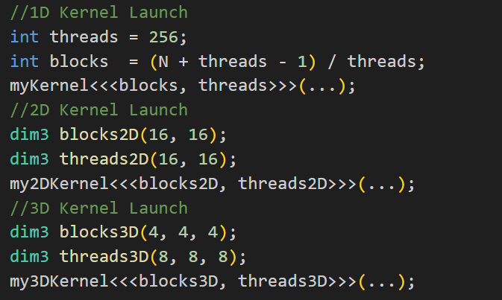

CUDA
Launching Kernals

Slide 8
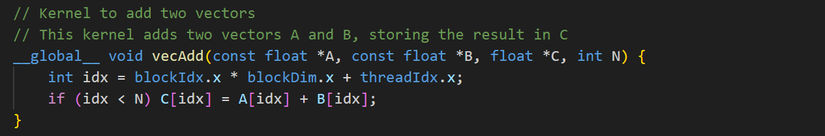
CUDA
Vector Addition

Slide 9
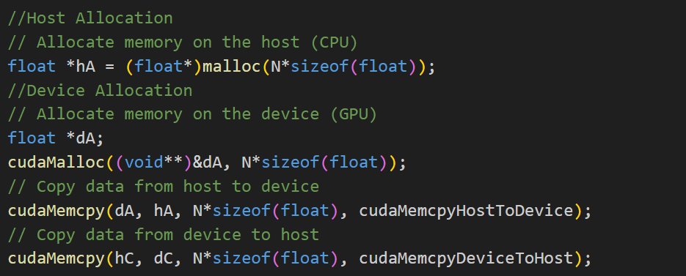
CUDA
Memory management

Slide 10
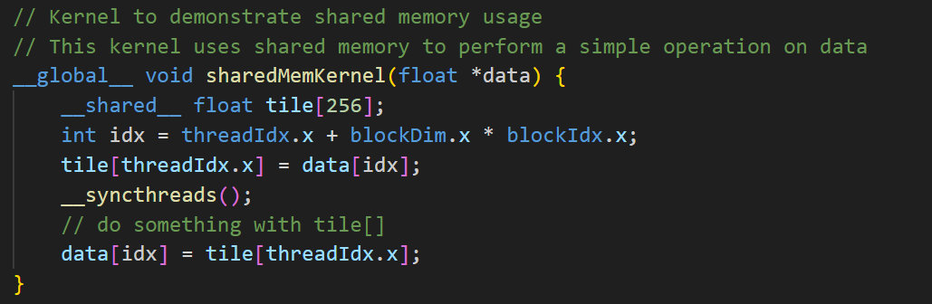
CUDA
Shared Memory

Slide 11
CUDA
Kernel Execution Flow
Allocate/transfer input data (host → device)
Launch kernel (<<<grid, block>>>)
Device executes kernel in parallel
Synchronize or wait for results
Transfer output data (device → host)
PAGE 11

Slide 12

CUDA
Thank
You!
Colab Note

